Slide 1

Xelerate Product
http://www.free-powerpoint-templates-design.com

Slide 2
Project Guide: Dr.Fousia Shamsudheen
Presented By: Ajmi A (TKM18MCA005)

Slide 3
Overview
Introduction
01
02
Product Versions
Xelerate Benefits to Clients
03
04
Xelerate Key Product Modules
Hardware and Software Specifications
05
06
Current Status

Slide 4

Introduction
Xelerate is the technology platform of SunTec Business Solution.
Xelerate is a Revenue Management and Business Assurance System.
It is a web application developed mainly using Java and Oracle.
The products are build on top of Xelerate platform

Slide 5
Product Versions
* TBMS – Telecom Billing Management System
TBMS * 1.x
TBMS 2.x
TBMS * 3.x
TBMS 4.x
TBMS 5.x
Xelerate 1.x
* TBMS – Transaction Business Management System

Slide 6
Xelerate – Benefits to Clients
A
Enabling the creation of highly flexible and trusted Personalized Product Offerings
Enabling the creation and proactive management of Customer Experience
Enabling high volume data driven decision making to achieve Business Assurance
B
Enabling comprehensive Revenue Management through flexible pricing and settlement structures

Slide 7
Xelerate Key Product Modules
Security and Administration
Product Catalogue
Customer and Account Management
Loyalty
Xelerate suite of products
Offer Management
Interfaces
Pricing
Invoicing and Payment Management

Slide 8
Hardware Specifications
Windows 7, Linux
12GB RAM
15GB Storage
Software Specifications
Java
Oracle SQL Developer

Slide 9
Current Status
Completed the X2.6 training and TPE training.
Currently doing the X2.6 Certification.

Slide 10
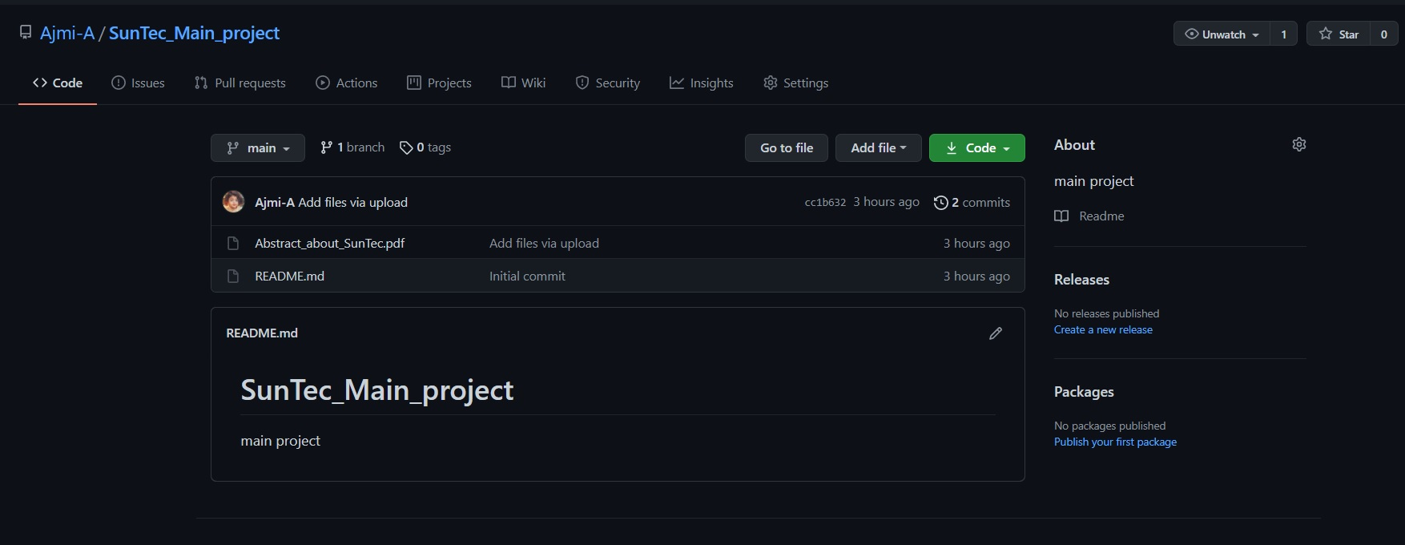
Screenshot – Git Repository

Slide 11
THANK YOU

